Slide 1
Exception Handling in Python

Slide 2
Course Contents
What is Exception?
Handling an exception
The except Clause with No Exceptions
The except Clause with Multiple Exceptions
The try-finally Clause
Argument of an Exception
Raising an Exception

Slide 3
What is Exception?
Python provides very important feature to handle any unexpected error in your Python programs and to add debugging capabilities in them called Exception.
An exception is an event, which occurs during the execution of a program that disrupts the normal flow of the program's instructions.
In general, when a Python script encounters a situation that it cannot cope with, it raises an exception.
An exception is a Python object that represents an error.
When a Python script raises an exception, it must either handle the exception immediately otherwise it terminates and quits.

Slide 4
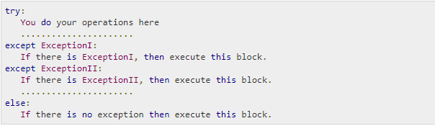
Handling an exception - I
If we have some suspicious code that may raise an exception, we can defend our program by placing the suspicious code in a try: block.
After the try: block, include an except: statement, followed by a block of code which handles the problem as elegantly as possible.
Here is simple syntax of try....except...else blocks −

Slide 5
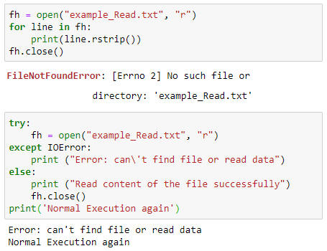
Handling an exception - I
After the except clause(s), one can include an else-clause. The code in the else-block executes if the code in the try: block does not raise an exception.
The else-block is a good place for code that does not need the try: block's protection.

Slide 6
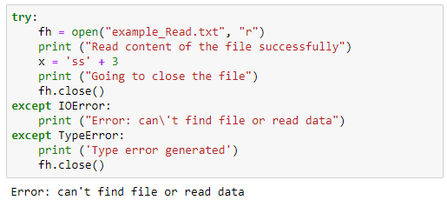
Handling an exception - II
A single try statement can have multiple except statements. This is useful when the try block contains statements that may throw different types of exceptions.
We can also provide a generic except clause, which handles any exception.

Slide 7
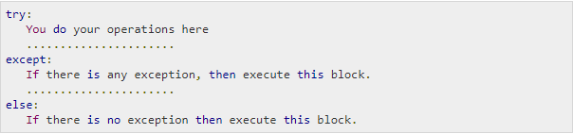
The except Clause with No Exceptions
One can also use the except statement with no exceptions defined as follows −
This kind of a try-except statement catches all the exceptions that occur.

Slide 8
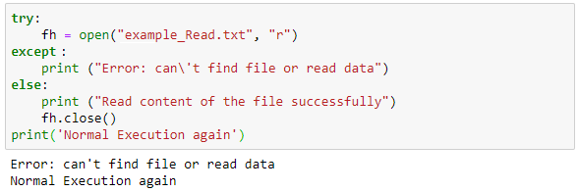
The except Clause with No Exceptions
Using this kind of try-except statement is not considered a good programming practice though, because it catches all exceptions but does not make the programmer identify the root cause of the problem that may occur.

Slide 9
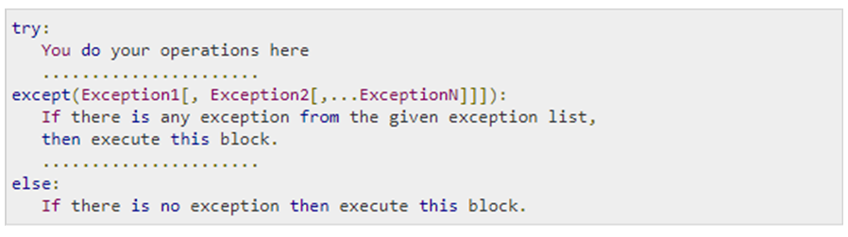
The except Clause with Multiple Exceptions
One can also use the same except statement to handle multiple exceptions as follows −

Slide 10
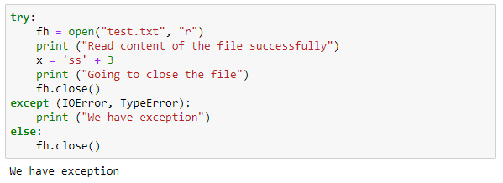
The except Clause with Multiple Exceptions

Slide 11
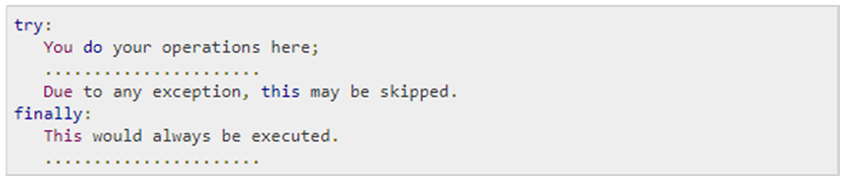
The try-finally Clause
One can use a finally: block along with a try: block.
The finally: block is a place to put any code that must execute, whether the try-block raised an exception or not.
The syntax of the try-finally statement is this −

Slide 12
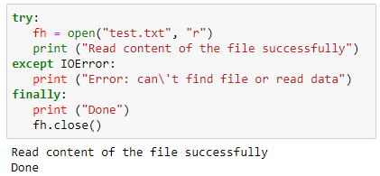
The try-finally Clause
One can provide except clause(s), with finally clause.
One can use else clause as well along with a finally clause.

Slide 13
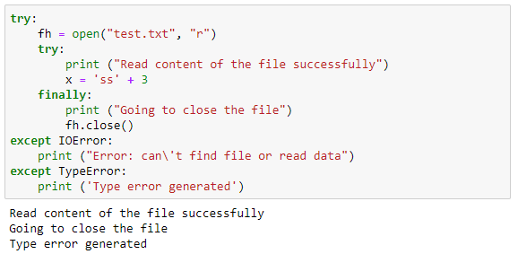
The try-finally Clause

Slide 14
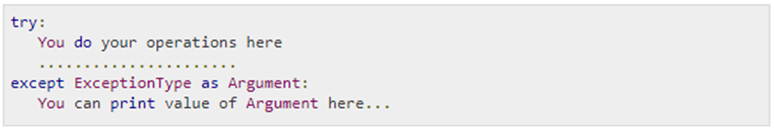
Argument of an Exception - I
An exception can have an argument, which is a value that gives additional information about the problem.
The contents of the argument vary by exception.
One capture an exception's argument by supplying a variable in the except clause as follows −

Slide 15
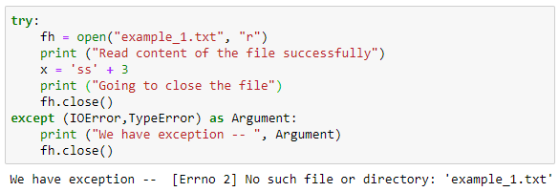
Argument of an Exception - II
If one write the code to handle a single exception, one can have a variable follow the name of the exception in the except statement.
If we are trapping multiple exceptions, we can have a variable follow the tuple of the exception.
This variable receives the value of the exception mostly containing the cause of the exception.
The variable can receive a single value or multiple values in the form of a tuple.
This tuple usually contains the error string, the error number, and an error location.

Slide 16
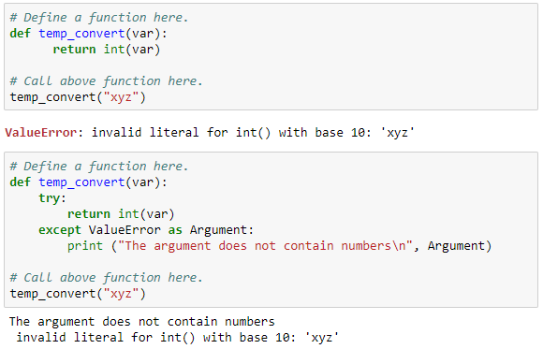
Argument of an Exception - II

Slide 17
Raising an Exception - I
We can raise exceptions in several ways by using the raise statement. The general syntax for the raise statement is as follows −
>>> raise [Exception [, args [, traceback]]]
Here, Exception is the type of exception (for example, NameError) and argument is a value for the exception argument.
The argument is optional; if not supplied, the exception argument is None.
The final argument, traceback, is also optional (and rarely used in practice), and if present, is the traceback object used for the exception.

Slide 18
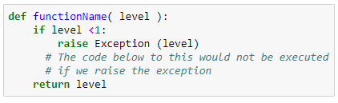
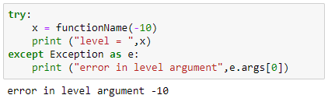
Raising an Exception - II
An exception can be a string, a class or an object.
Most of the exceptions that the Python core raises are classes, with an argument that is an instance of the class. Defining new exceptions is quite easy and can be done as follows −
In order to catch an exception, an "except" clause must refer to the same exception thrown either as a class object or a simple string.
For example, to capture the above exception, we must write the except clause as follows −
Notes:
My_Exception

Slide 19
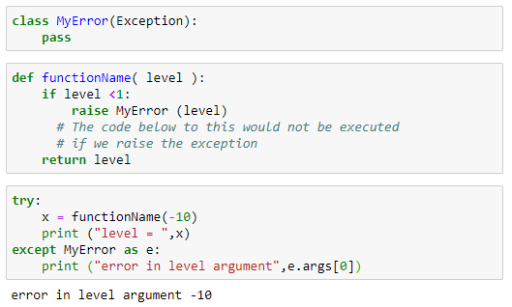
Raising User-defined Exceptions
Notes:
My_Exception

Slide 20
Summary
We have implemented Handling an exception
We tried with The except Clause with No Exceptions and The except Clause with Multiple Exceptions
Also tried with The try-finally Clause , Argument of an Exception and Raising an Exception.

